Slide 1


Notes:
10 years WOW!
Proud to see how much the group has grown
Congratulate you
10 more!

Slide 2


Watch User Group presentations for FREE online!
All the topics you care about
Including:
Agile
C#
Entity Framework
HTML5
MVC
Silverlight
XAML
jQuery
and Much More!
Miss a User Group meeting?
Forget something that you learned?
Want to see content from a User Group not in your area?
Want to share with a buddy?
We know you cannot make it to every User Group meeting,
that is why we post them online for you!
We now have over 425 presentations online
That is over 100 GB of video
New Content added all the time!
Presentations from the thought leaders on the topic.
For new content announcements
@UserGroupTV
http://www.UserGroup.tv

Slide 3

Why Community?
Shawn Weisfeld
@shawnweisfeld
shawn@shawnweisfeld.com

Slide 4

Notes:
Learning new things

Slide 5

Notes:
Invest in you

Slide 6
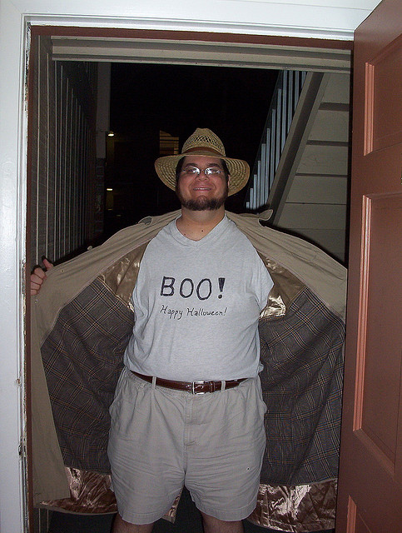
Notes:
Exposure to new topics

Slide 7

Notes:
Meet new people

Slide 8

Notes:
Get out what you put in

Slide 9

Notes:
Get a new job

Slide 10

Notes:
Fun

Slide 11

Notes:
Free Pizza

Slide 12

Shawn Weisfeld
@shawnweisfeld
shawn@shawnweisfeld.com
Notes:
Act Now

